Slide 1
Milestone 3: Wine Quality Prediction
Sreenivasulu Somu
Bellevue University
DSC680-T301 Applied Data Science
Amirfarrokh Iranitalab

Slide 2

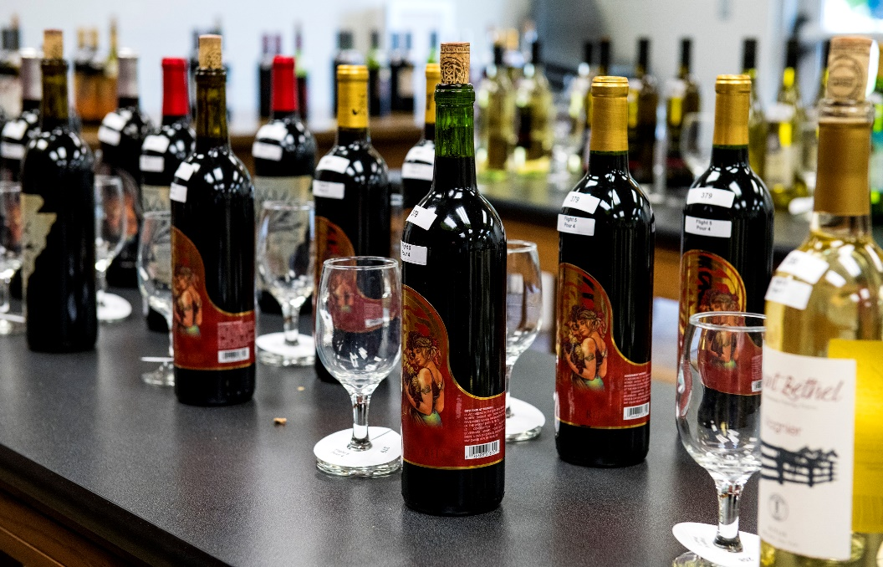
Objective
Wine producers struggle with consistent quality control.
Traditional quality assessment relies on subjective human tasters, leading to inefficiencies.
Objective, data-driven models can optimize production and improve decision-making.

Slide 3
Data Explanation
Dataset:
6,497 wine samples (1,599 red, 4,898 white)
Features:
11 physicochemical properties
Quality Ratings:
Scale of 3 to 9 (higher values indicate better quality)

Slide 4
Data Preparation Steps
Combining Red & White Wine Data
Added wine type identifier
Missing Values
Addressed appropriately
Feature Scaling
Applied StandardScaler for regression models
Train-Test Split
80% training, 20% testing with stratified sampling

Slide 5
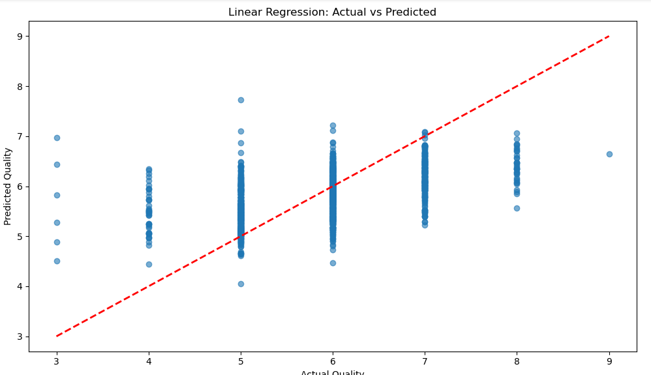
Charts Explanation
Actual vs Predicted Quality Scatter Plot
Most predictions fall between quality ratings of 5-7, showing accurate clustering.

Slide 6
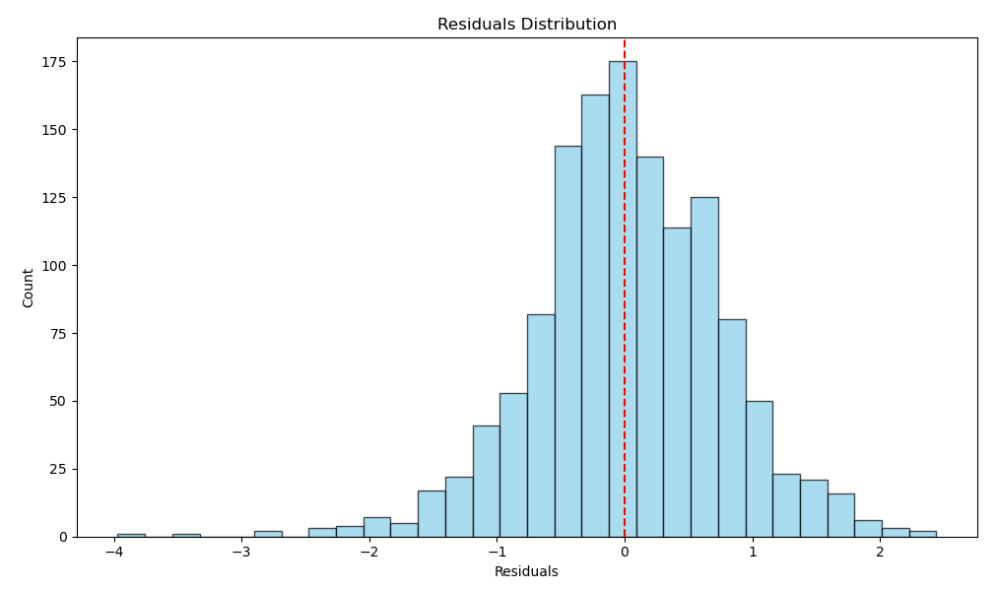
Charts Explanation
Residual Distribution Histogram
Bell-shaped distribution centered around zero, indicating unbiased predictions.

Slide 7
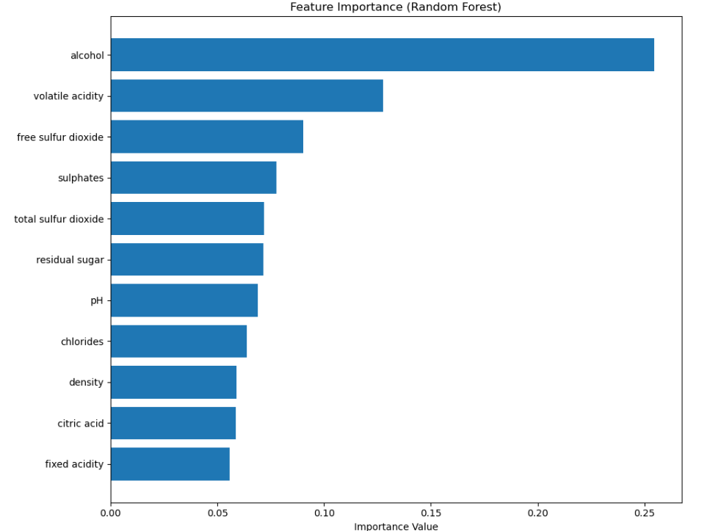
Charts Explanation
Feature Importance from Random Forest:
Top Predictors: Alcohol content, volatile acidity, sulphates.

Slide 8
Methods
Four supervised classification models implemented
Logistic Regression
Naive Bayes
Support Vector Machines (SVM)
Random Forest
Models trained and evaluated using cross-validation to ensure robust results.

Slide 9
Results and Interpretation
Model | Accuracy | Precision | Recall | F1
Logistic Regression | 0.821538 | 0.609091 | 0.261719 | 0.366120
Naive Bayes | 0.750769 | 0.411917 | 0.621094 | 0.495327
SVM | 0.831538 | 0.672897 | 0.281250 | 0.396694
Random Forest | 0.881538 | 0.783333 | 0.550781 | 0.646789

Slide 10
Conclusion
ML models can predict wine quality effectively from chemical data.
Random Forest is most robust, capturing non-linear relationships and feature interactions.
Key predictors: alcohol, volatile acidity, sulphates.
Recommended for real-time quality control in production.

Slide 11
Ethical Assessment
Models rely on expert ratings as ground truth, which may be subjective.
Limited to Portuguese wines; may not generalize globally.
Data-driven automation could impact traditional roles in wine evaluation.
Transparency and fairness should be considered in deployment.

Slide 12
Audience Questions
How can this analysis help reduce production costs while maintaining quality standards?
What is the business impact of implementing predictive quality models in wine production?
How does this approach compare to traditional quality assessment methods in terms of accuracy and efficiency?
What preprocessing steps were most critical for model performance, and how did feature scaling affect results?
How is the train-test split strategy chosen, and what validation techniques ensured model robustness?
What feature engineering techniques could potentially improve model performance beyond the current 65% R² score?
Why did Random Forest outperform Linear Regression, and what does this suggest about the underlying data relationships?
How were hyperparameters optimized for both models, and what cross-validation strategy was employed?
What are the implications of the residual patterns observed in the linear regression analysis?
How can the model predictions be integrated into existing production workflows to achieve the primary objective of consistent quality improvement?

Slide 13
Thank you

